Slide 1
Searching and sorting algorithms
3 / 4 Software Development

Slide 2
Searching algorithms

Slide 3
Linear search
How does it work?
Start from the beginning of a list of items and iterate through the list until you find the searched for item
Examples:
Search for 45 - Start at 11, then check 27, then 18, then 45, then stop - item found
Search for 100 - Start a 11, then check 27, then 18, then 45, then 1, then 98, then 33, then 22, then 48, then stop - item NOT found
11 27 18 45 1 98 33 22 48

Slide 4
Linear search
Advantages
Intuitive
Simple to code
Disadvantages
Slow on large amounts of data in comparison to a Binary search

Slide 5
Binary search
How does it work?
Starting with a sorted list look at the middle value (midpoint)
Determine if you need to go higher or lower
Repeat these steps until you either find the searched for value or have checked through the whole list

Slide 6
Binary search example
Searching for 33 - 1st pass
1 12 13 17 24 29 30 33 48

Slide 7
Binary search example
Searching for 33 - 2nd pass
(Go lower where there is an even number, VCAA 2020 Case study Q10)
1 12 13 17 24 29 30 33 48

Slide 8
Binary search example
Searching for 33 - 3rd pass
COMPLETE - Number found
1 12 13 17 24 29 30 33 48

Slide 9
Binary search example
Searching for 8 - 1st pass
1 12 13 17 24 29 30 33 48

Slide 10
Binary search example
Searching for 8 - 2nd pass
1 12 13 17 24 29 30 33 48

Slide 11
Binary search example
Searching for 8 - 3rd pass
COMPLETE - Number not found
1 12 13 17 24 29 30 33 48

Slide 12
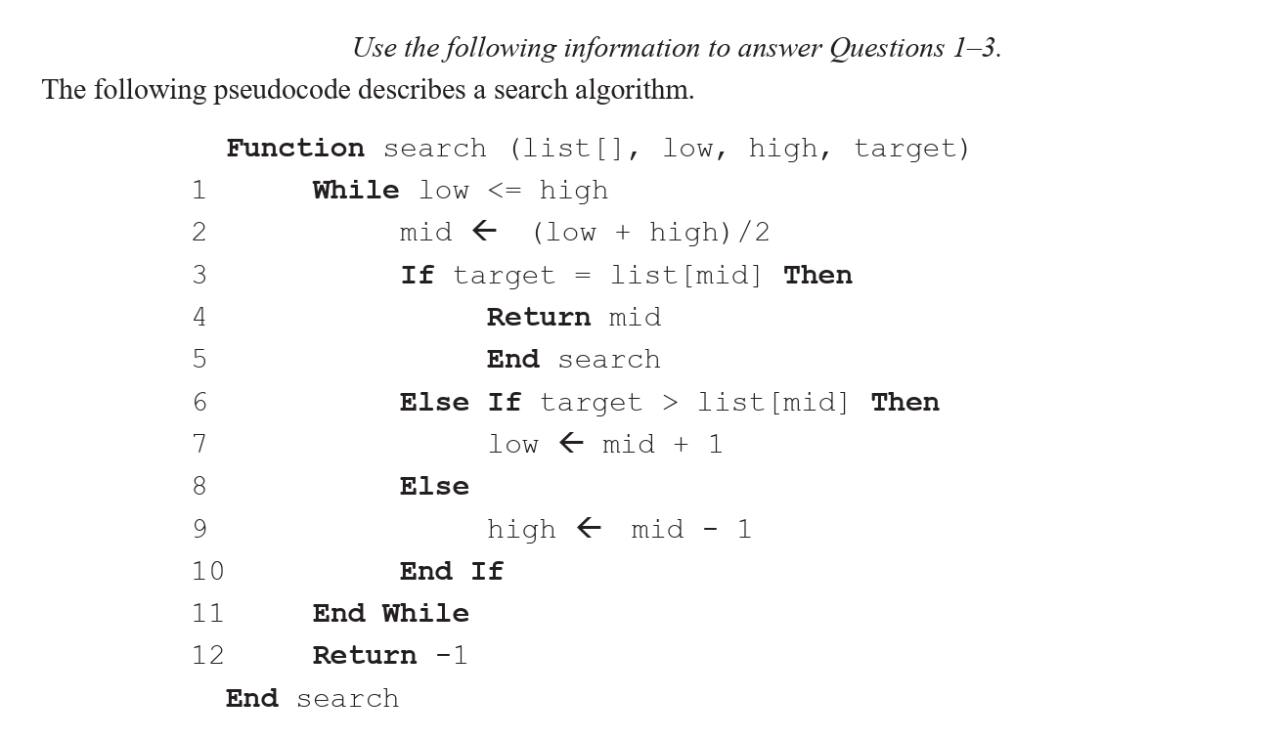
2023 VCAA exam

Slide 13
Binary search
Advantages
More efficient than linear search on larger data sets
Disadvantages
Data needs to be sorted

Slide 14
Sorting algorithms

Slide 15
Selection sort
How does it work?
Find the smallest item in the list. Swap the smallest item with the item in the first slot.
Then move on to the second slot, and repeat until the whole list is sorted

Slide 16
Selection sort example
Sort list - 1st pass
Find the value for the first position and swap with the current item in that position
Find
20 3 13 71 2 29
Swap
2 3 13 71 20 29

Slide 17
Selection sort example
Sort list - 2nd pass
Find the value for the second position and swap with the current item in that position
Find
2 3 13 71 20 29
Swap not necessary!
2 3 13 71 20 29

Slide 18
Selection sort example
Sort list - 3rd pass
Find the value for the third position and swap with the current item in that position
Find
2 3 13 71 20 29
Swap not necessary!
2 3 13 71 20 29

Slide 19
Selection sort example
Sort list - 4th pass
Find the value for the fourth position and swap with the current item in that position
Find
2 3 13 71 20 29
Swap
2 3 13 20 71 29

Slide 20
Selection sort example
Sort list - 5th pass
Find the value for the fifth position and swap with the current item in that position
Find
2 3 13 20 71 29
Swap
2 3 13 20 29 71

Slide 21
Selection sort
Advantages
Intuitive
Simple to code
Disadvantages
Less efficient compared to Quick sort

Slide 22
Quick sort
How does it work?
Quick sort is a ‘divide-and-conquer algorithm’ i.e. split the array into two smaller parts, and get each part right.
Here’s how it works:
  Pick an item in the array, called “the pivot”. (It doesn’t matter what item, you will probably be told what e.g. the last item).
  Make up two arrays of values, above and below the pivot.
  Repeat the above two steps on each of these arrays etc.

Slide 23
Quick sort example
Sort list - 1st pass
Sort values to the left or right of the pivot
Select pivot
20 3 13 71 2 29
Sort sub arrays
3 13 2 20 71 29

Slide 24
Quick sort example
Sort list - Subsequent passes
Repeat the process for each sub array, working off the assumption 20 is now in the correct position
{
3 13 2 20 71 29
{

Slide 25
Quick sort
Advantages
More efficient compared to Linear sort
Disadvantages

